Slide 1
Advanced Deep Learning Architectures COMP 5214 & ELEC 5680
Instructor: Dr. Qifeng Chen
https://cqf.io

Slide 2
Logistics
Assignment 3 has been released today
https://course.cse.ust.hk/comp5214/programs/index.html
Due on 11 May 2022

Slide 3
Course Project Presentation
Submit the course project presentation as a video by May 4 on Canvas
We will play the videos on May 5 and 10
Each video is up to 4 minutes as we have 38 groups

Slide 4

Recording presentation videos
Turn on Automatic recording after signing in your Zoom account in the webpage. Click Settings -> Recording.

Slide 5
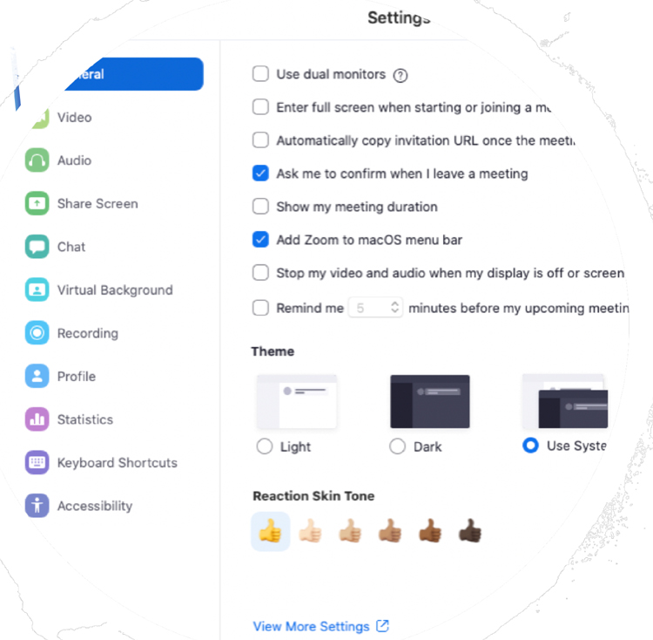
Recording presentation videos
Video/audio: make sure that you are using a computer with camera (either an embedded front-face camera or a connected camera) and microphone (built in or connected). Select the correct options (Video and Audio) in the Settings in the Zoom client.

Slide 6
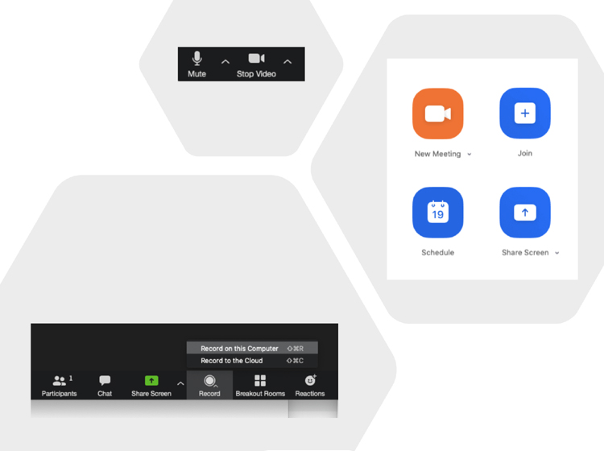
Recording presentation videos
Start the application for slides presentations such as PowerPoint or Keynote. Open the Zoom client and sign into your account. Click New Meetings. Make sure that local recording starts automatically. If not, you can manually turn it on. Make sure your microphone is not muted and your video is started.

Slide 7
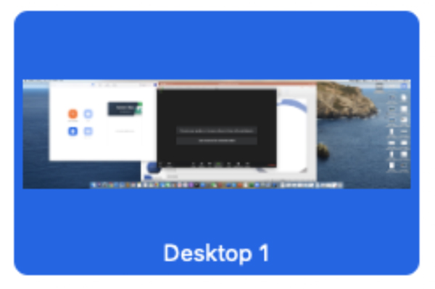
Recording presentation videos
Click Share Screen and select the presentation application, e.g., PowerPoint or Keynote. Do not share the entire desktop. Do not select Share computer sound or Optimize Screen Share for Video Clip.

Slide 8
Recording presentation videos
Reminder Tips for high-quality talks 1. Keep it simple and avoid too many technical details. 2. Best first: start your presentation with the most important/exciting point. 3. Use figures and examples wisely. 4. Keep a good pace and use a timer to help.
Now double check: • The video resolution is at least 720p • The video format is .mp4 or .m4v format, optimized for streaming; the Video Codec is H.264 and the Audio Codec is AAC+ or AAC. MPEG4 PART 10 or AVC • Audio and video tracks are in sync at all times • Included a picture-in-picture video window of the presenter throughout the video

Slide 9
Implicit Models for Scene Representations

Slide 10
DeepSDF: Learning Continuous Signed Distance Functions for Shape Representation
Jeong Joon Park, Peter Florence,
Julian Straub, Richard Newcombe, Steven Lovegrove
University of Washington, MIT, FB Reality Labs
Project page
https://github.com/facebookresearch/DeepSDF
Presenter: Ka Ho, Lee

Slide 11
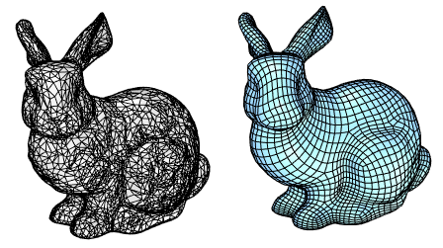
Background
Objective: learned continuous SDF to represent a class of shapes
Used to be:
Mesh (triangle, Quadrilateral)
Issues:
Not continuous
Not differentiable

Slide 12
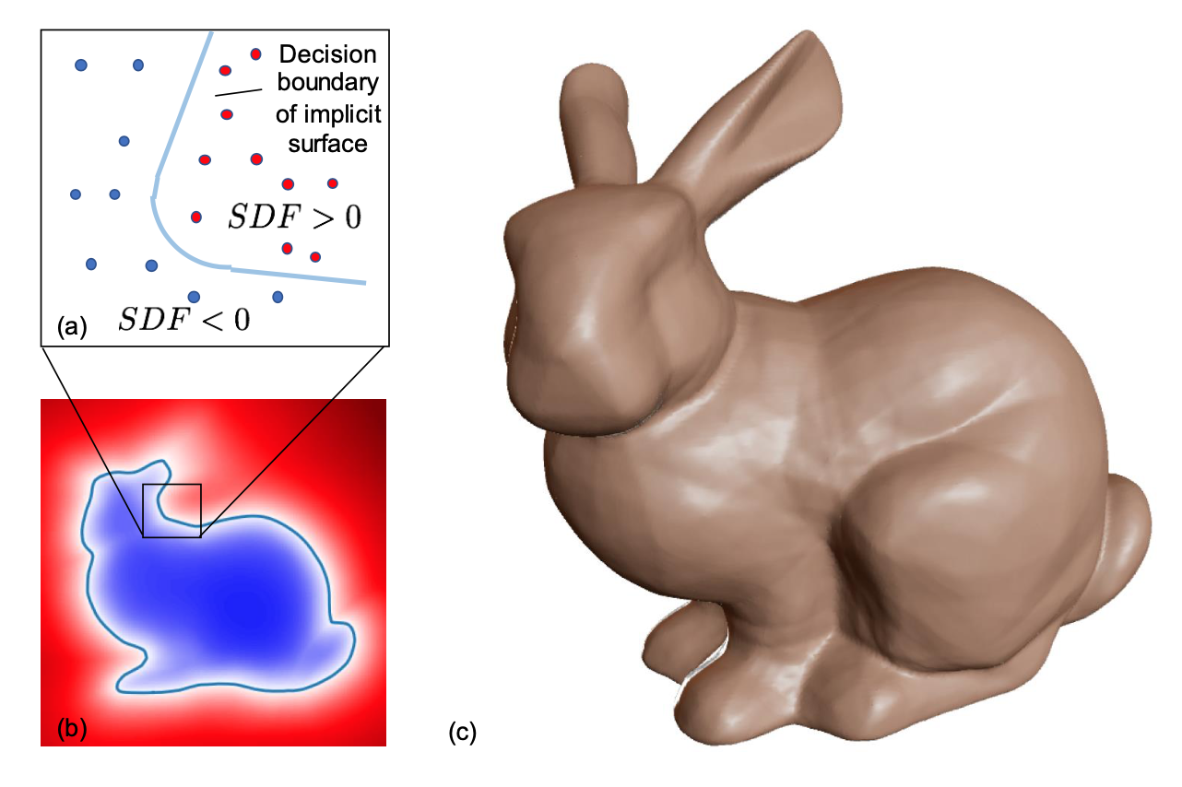
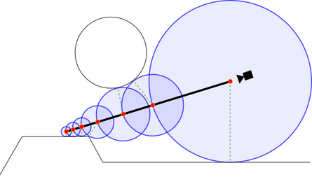
Background Knowledge Signed Distance Function (SDF)
SDF
Querying a point, return the shortest distance to the object surface
SDF in Rendering, Signed Distance Field
Similar to Raytracing

Slide 13
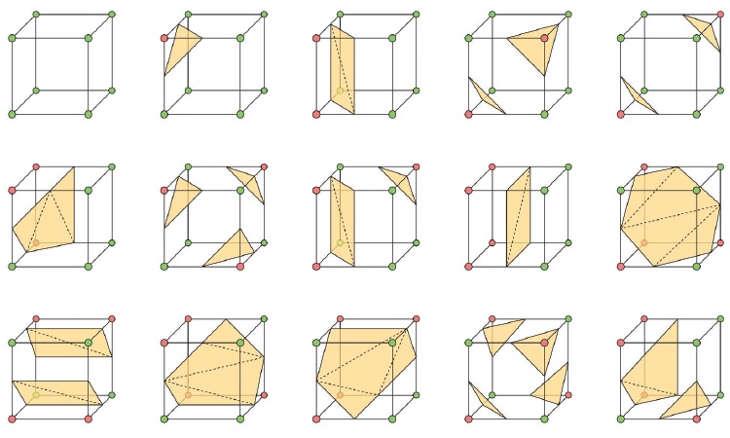
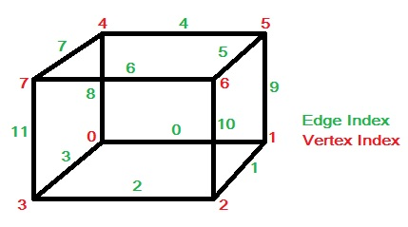
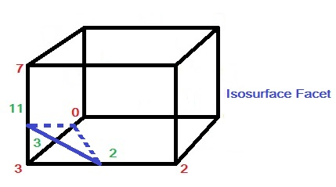
Background knowledge Marching Cubes - generating a mesh from SDF
Grids
Interpolate
Forming faces
Example: assume V₃ smaller than the surface value while others are larger than
P = P₁ + (V – V₁)·(P₂ – P₁)/(V₂ – V₁)

Slide 14
Paper Contributions
Formulating generative shape-conditioned 3D modeling with a continuous implicit surface
Proposing learning method for 3D shapes based on a probabilistic auto-decoder
Demonstrating and applicating this formulation to shape modeling and completion
What truly unique,
Reconstructing object from part of it
Representing a class of similar shape, e.g. vechicle, chair

Slide 15
Related work - Representations for 3D Shape Learning
Point-based - Point Cloud e.g. PointNet
Issue:
do not describe topology
not suitable for producing watertight surfaces.
Mesh-based – Triangle, Quad Meshs
Issue:
can only model shapes with fixed mesh topology
Voxel-based – Voxels
Issue:
Low resolution

Slide 16
Related works - Representation Learning Technique
Generative Adversial Networks (GAN)
Idea:
Projecting normal distribution to dataset’s distribution
Issue:
Unstable
Auto-encoders
Idea:
Encoder and Decoder pair
Issue:
Uncertainty of latent code distribution -> Variational Auto-Encoder (VAE)
*Optimizing Latent Vectors
Optimize latent vector for backward propagation
Idea from: “Optimizing the Latent Space of Generative Networks” ICML2018

Slide 17
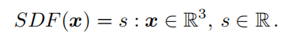
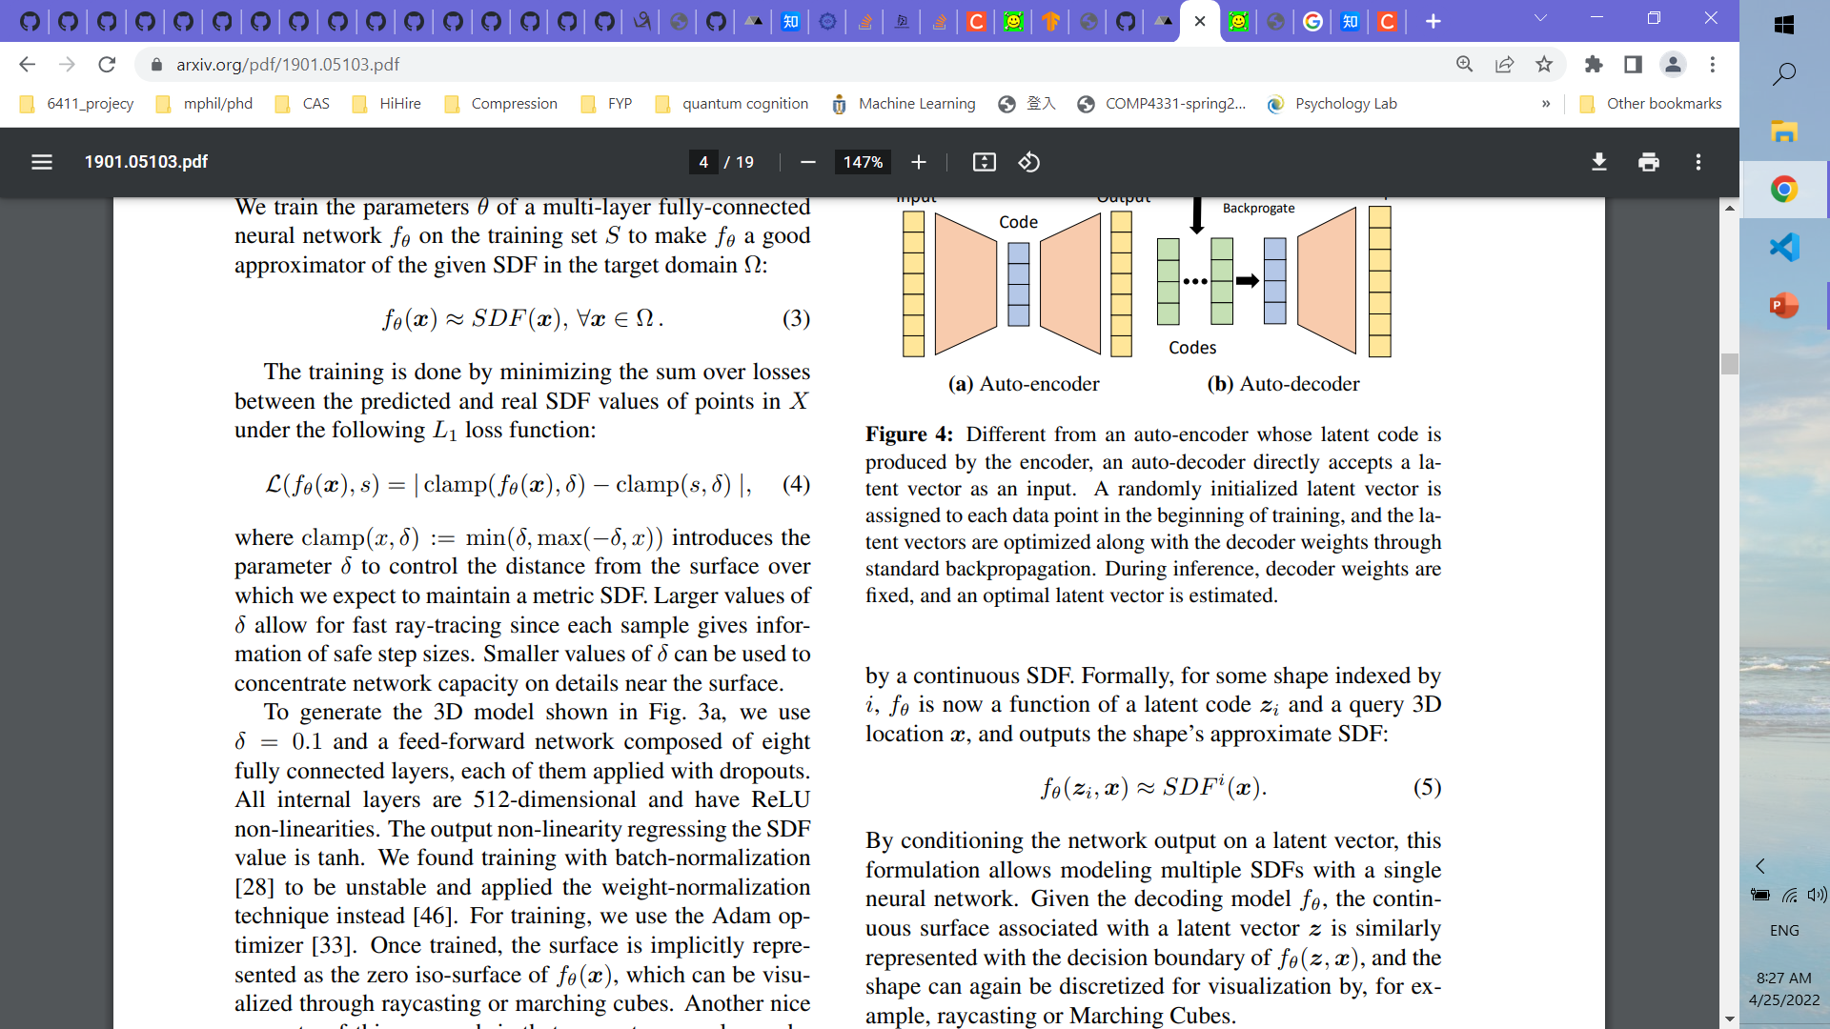
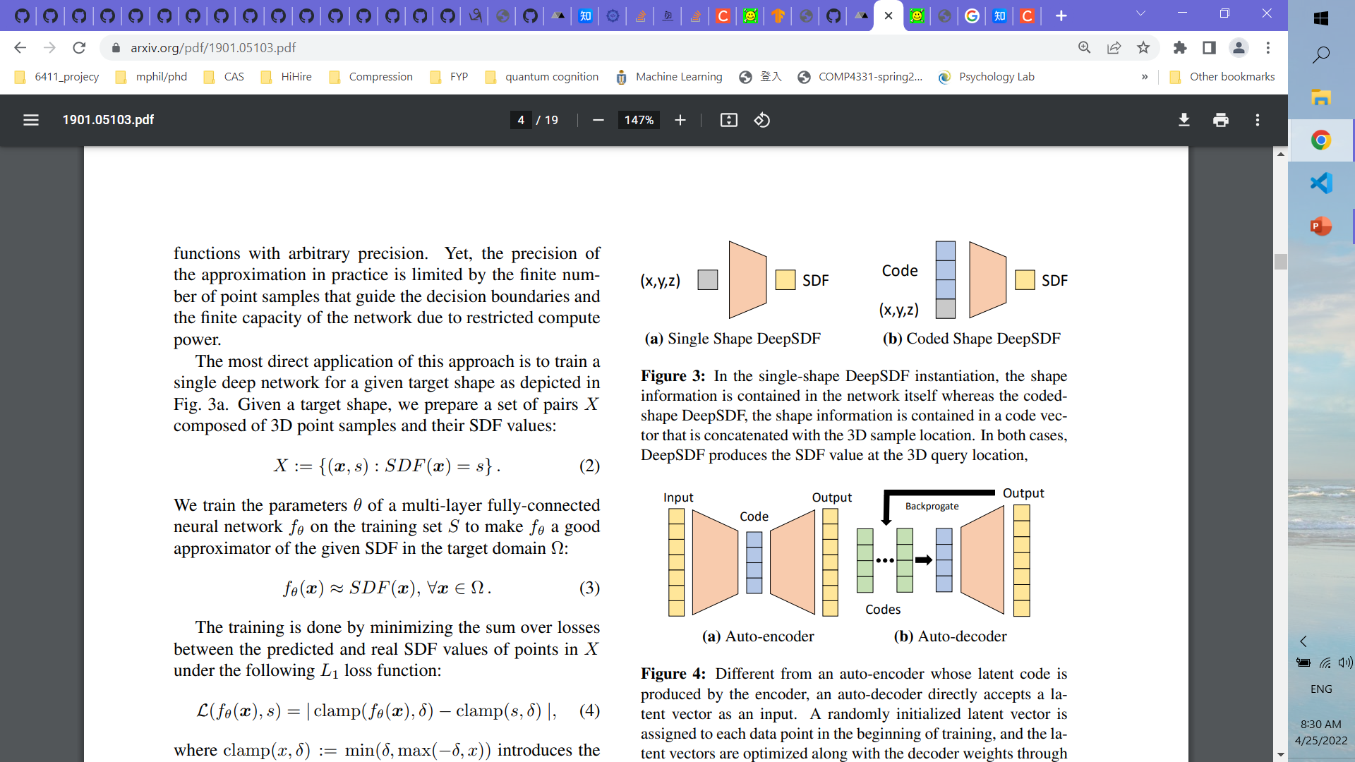
Methodology Workthrough
SDF
underlying surface is implicitly represented by the iso-surface of SDF(·) = 0
Training Loss
where clamp(x, δ) := min(δ, max(−δ, x)) introduces the parameter δ to control the distance from the surface over
3. Learning the Latent Space of Shapes

Slide 18
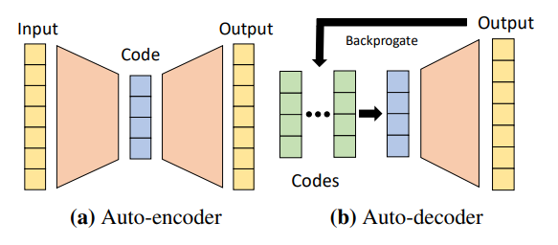
Methodology Workthrough
Training
1. Without encoder
2. Input random generated latent code + (x,y,z)
3. Forward to get loss
4. Backward to update both latent code and decoder
Testing
1. Input random generated latent code + (x,y,z)
2. Forward to get loss
3. Backward to update only latent code
4. Optimized latent code can be used to query unseen 3d-points

Slide 19
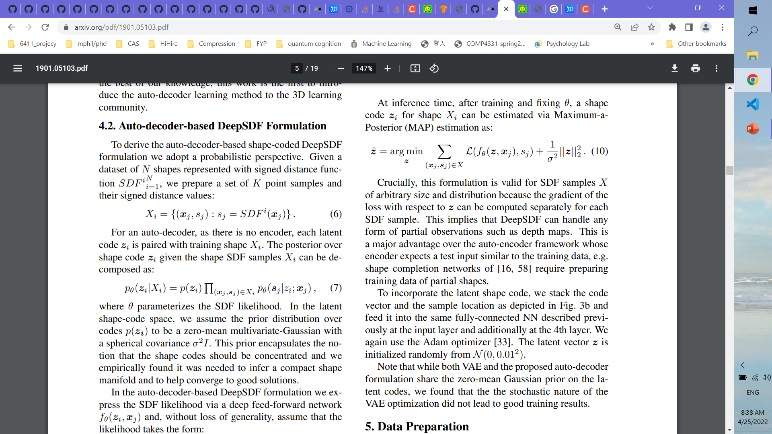
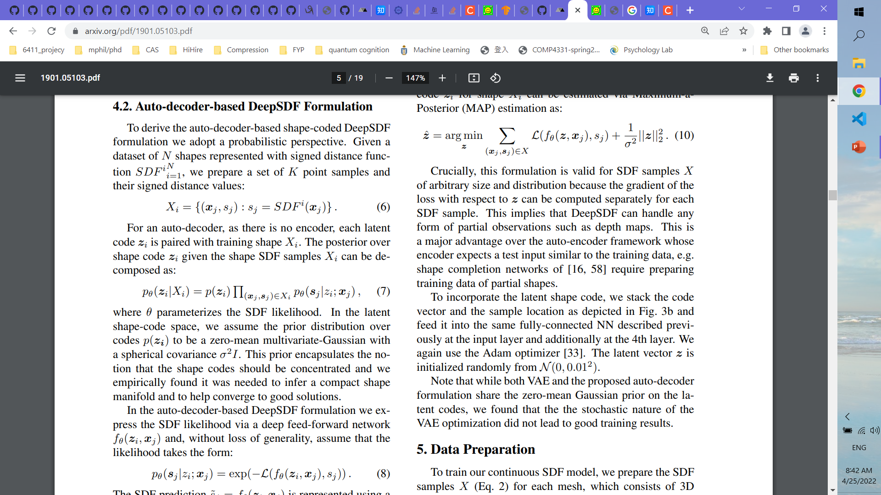
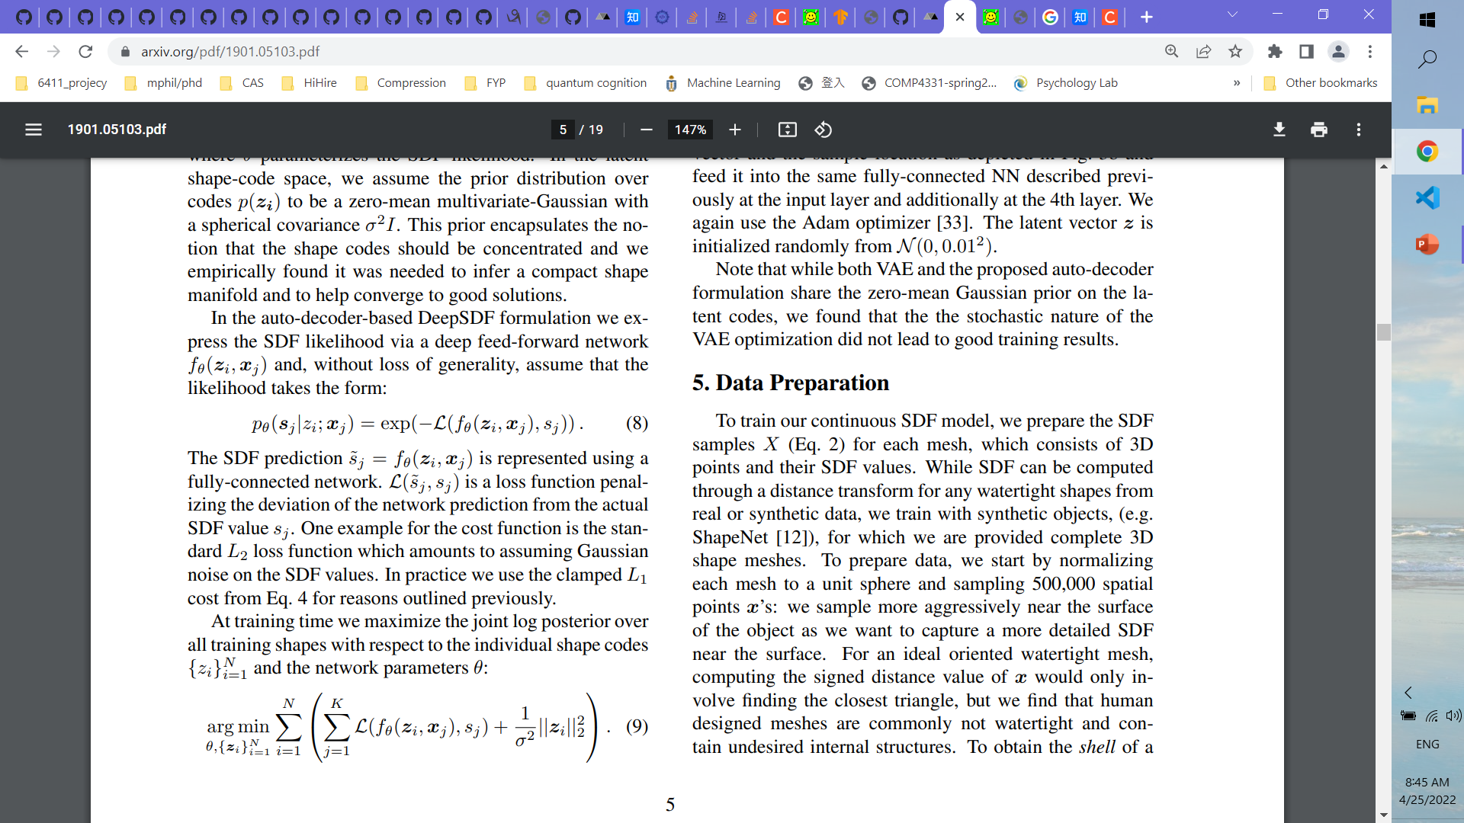
Methodology Math Workthrough
Given a dataset of N shapes represented with SDF SDF^{i N} _{i=1}, prepare a set of K point samples and their SD values
For an auto-decoder, each latent code z_{i} is paired with training shape X_{i}
The posterior over shape code z_{i} given the shape SDF samples X_{i}
SDF likelihood Formulation

Slide 20
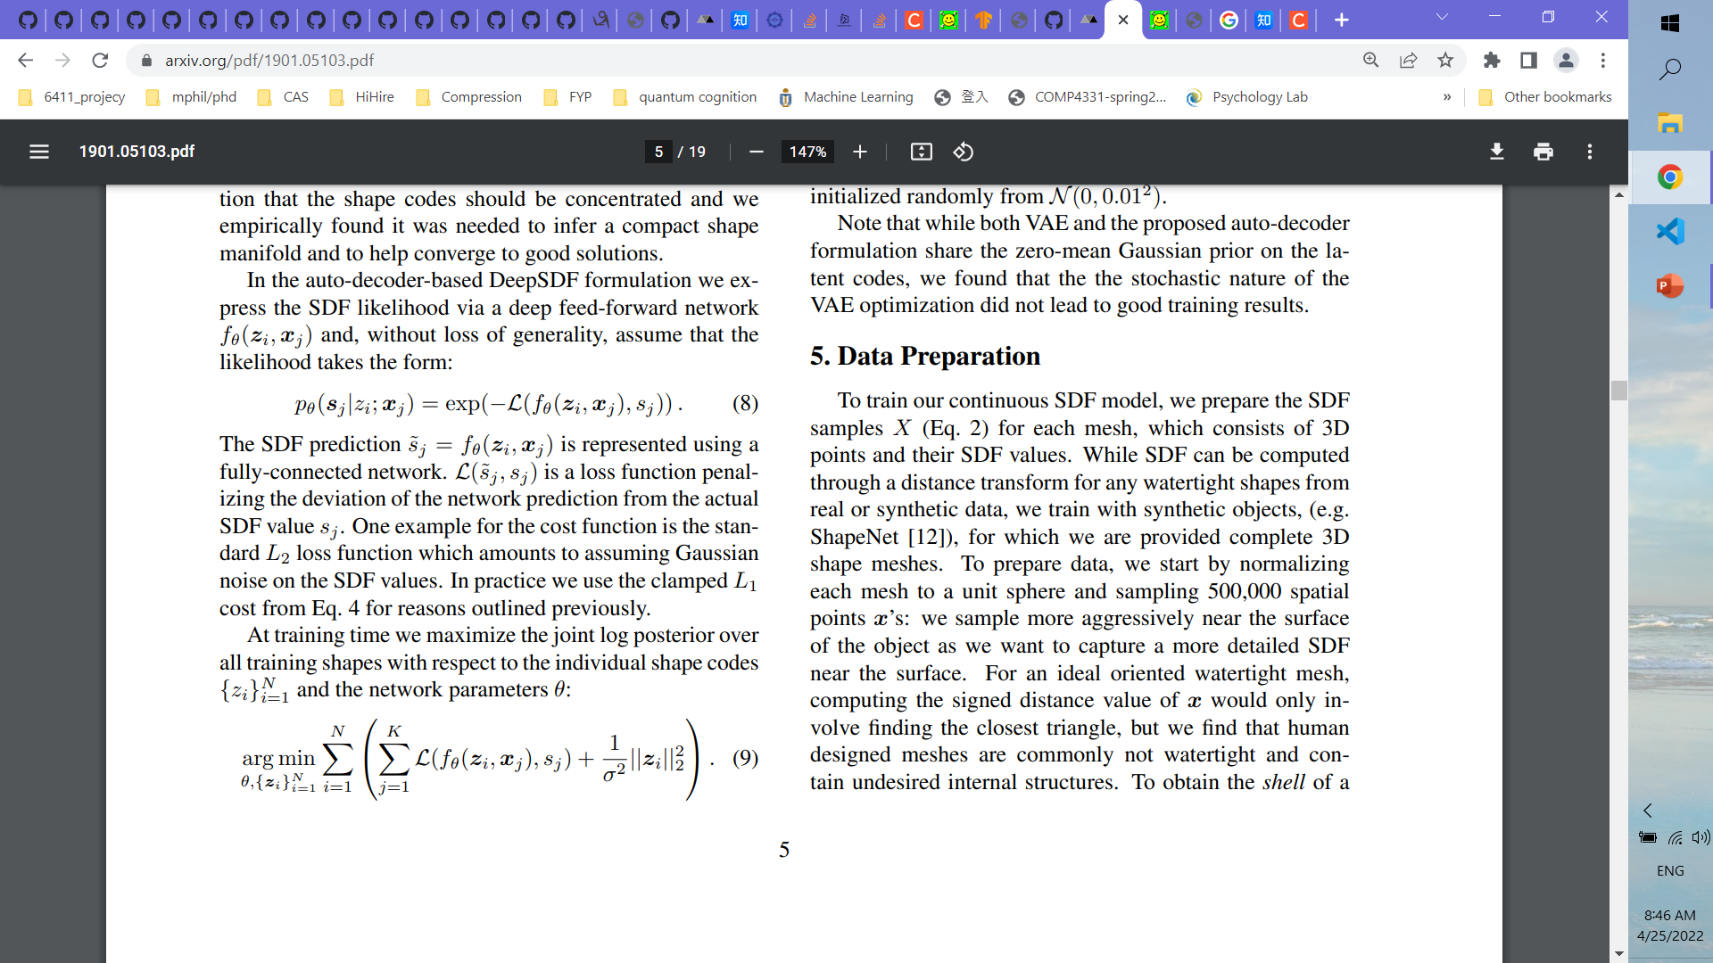
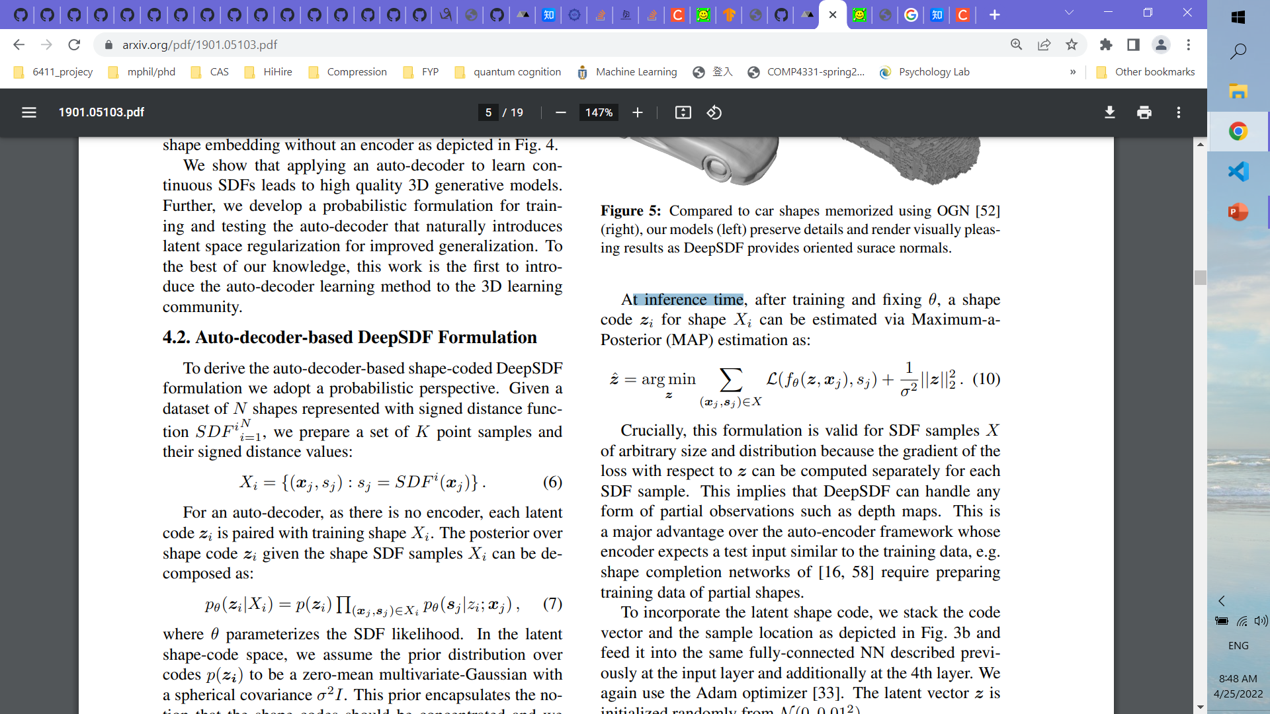
Methodology Math Workthrough
Training time
Maximize the joint log posterior over all training shapes with respect to the individual shape codes {z_{i}} ^{N}_{i=1} and the network parameters θ
Inference time
after training and fixing θ, a shape code zi for shape Xi can be estimated via Maximum-a-Posterior (MAP) estimation

Slide 21
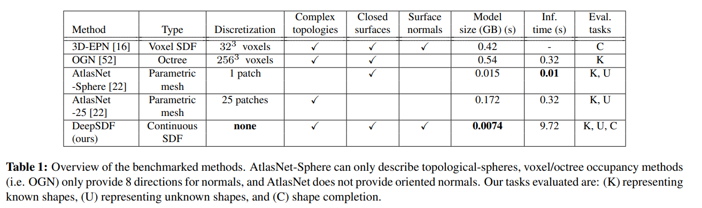
Experiments – Comparison on benchmark characteristics

Slide 22
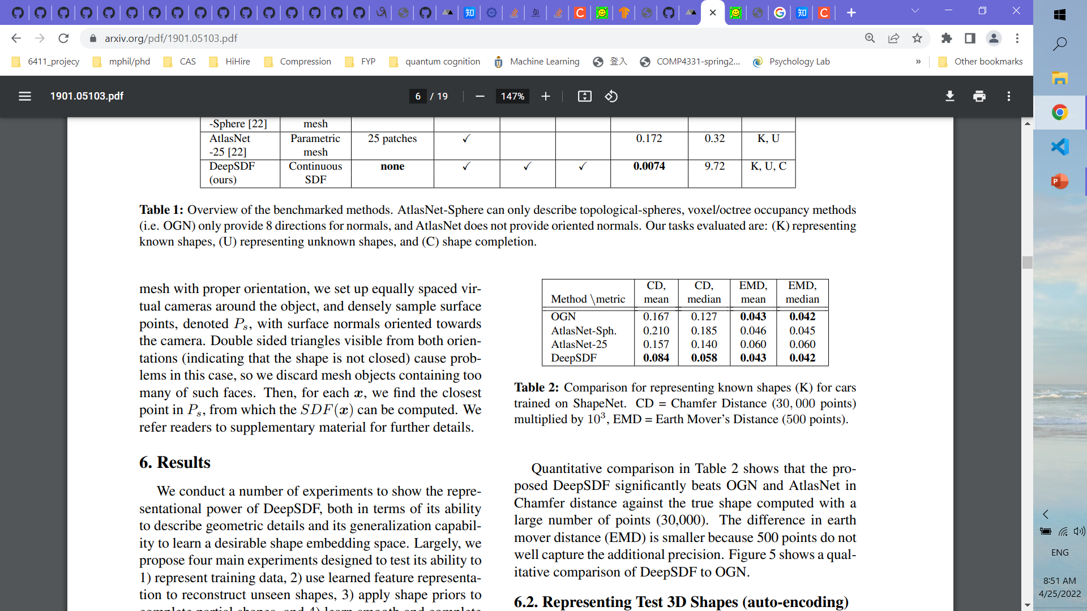
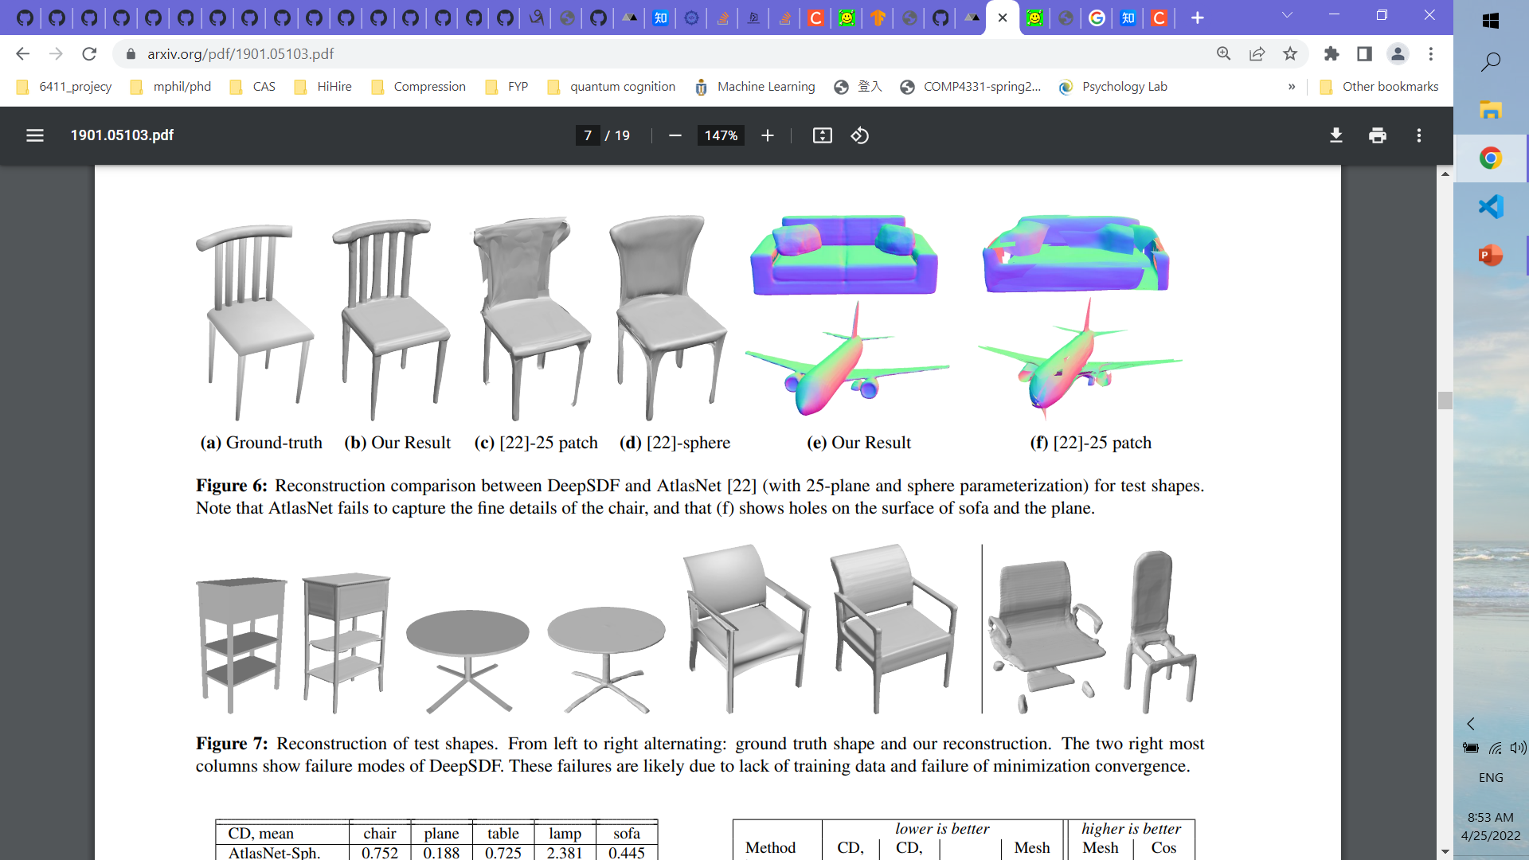
Experiments – Comparison on benchmark result
Metrics: Chamfer Distance, Earth’s Mover Distance
Visual Results:

Slide 23
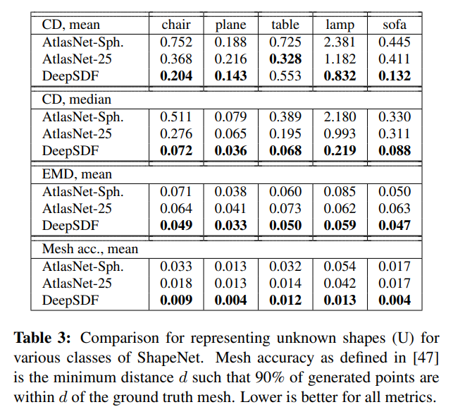
Experiments – Comparison for representing unknown shapes for various classes
Visual Results:

Slide 24
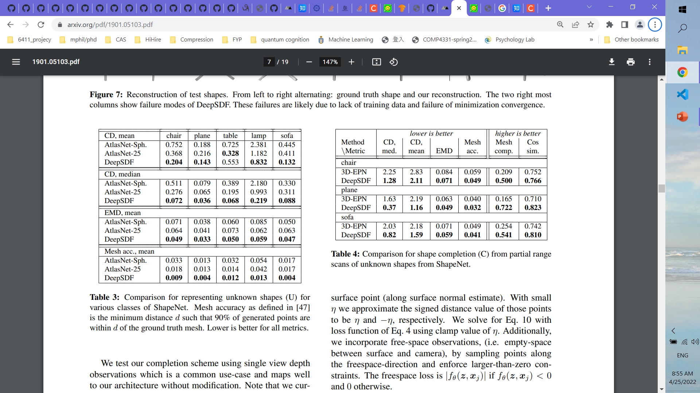
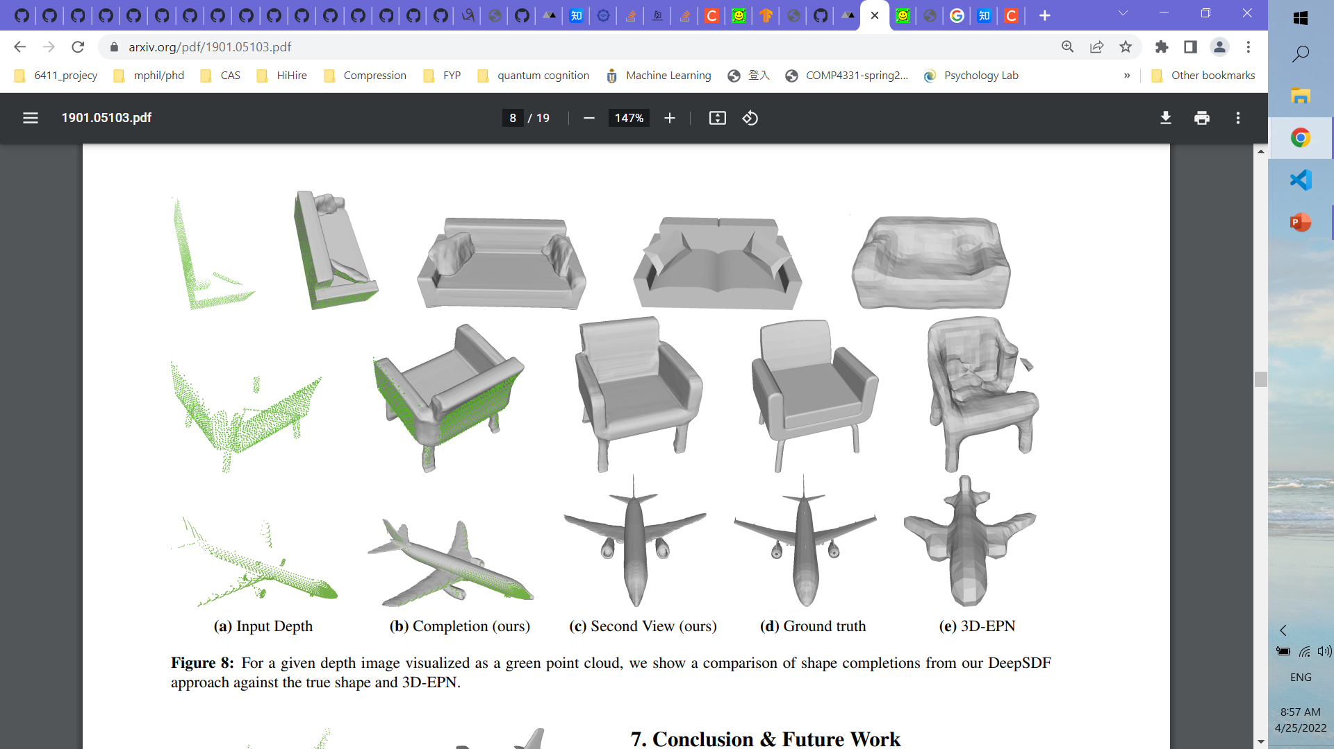
Experiments – Comparison for shape completion from partial range scans of unknown shapes

Slide 25
More training details and result comparison can be found in the Supplements

Slide 26
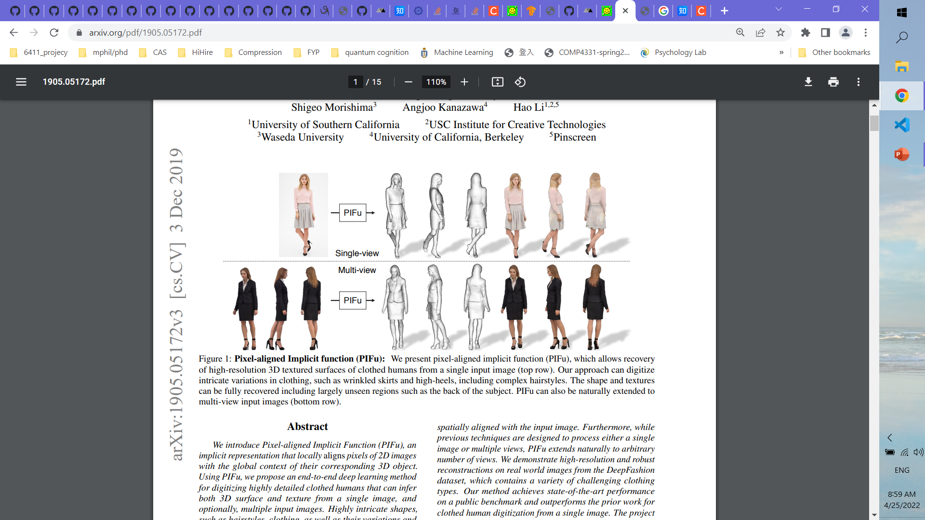
PIFu: Pixel-Aligned Implicit Function for High-Resolution Clothed Human Digitization
Shunsuke Saito, Zeng Huang, Ryota Natsume,
Shigeo Morishima, Angjoo Kanazawa, Hao Li
USC, USC Institute for Creative Technologies, Waseda University, UCB, Pinscreen
Project page
https://shunsukesaito.github.io/PIFu/

Slide 27
Background
Objective: Infering both 3D surface and texture from a single image
Situation at that time:
For domain-specific objects, (ie. faces, human bodies, man-made objects), already possible to infer good 3D surfaces from images using parametric models, data-driven techniques, or deep neural networks
FCN works in 3D shape representation was not well-explored
Issues:
Resolution limited due to ineffective mode representation
- Texture inference Is hard

Slide 28
Paper Contributions
Aligning local features at the pixel level to the global context of the entire object
Not requiring high memory usage as in voxel representation
Can be extended to arbitrary number of views as input

Slide 29
Related works - 3D Human Digitization
Parametric models :
E.g. SCAPE, SMPL
Adv:
Capability to capture human body measurements and motions
Issue:
Only produce a naked human body - 3D surfaces (ie. clothing, hair, and other accessories) are all ignored

Slide 30
Related works – Texture Inference
Synthesis back view from front one (e.g.Siclope)
Issue:
Self-occluding regions and side views cannot be handled
Directly predicts RGB values on a UV Inference
“Learning category-specific mesh reconstruction from image collections”
Issue:
Can only handle known topology -> not suitable for clothing inference

Slide 31
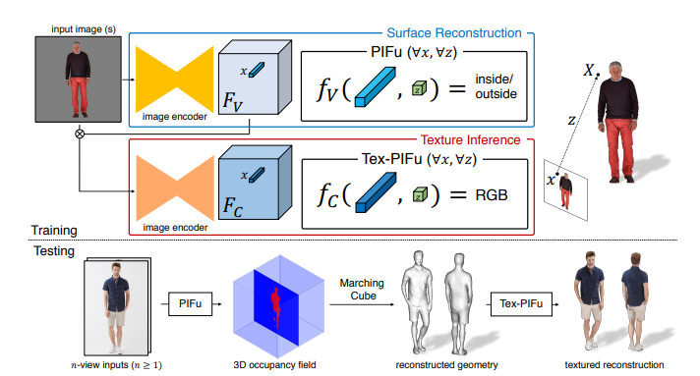
Proposed Method
Two branches
Surface Reconstruction
Texture Reconstruction

Slide 32
Proposed Method
Each branch
Image Encoder to get the feature (Hourglass)
Gather the feature at the pixel + querying depth for the pixel ->return occupancy RGB value
For Texture Branch
Input image constrained by Surface Branch’s image feature

Slide 33
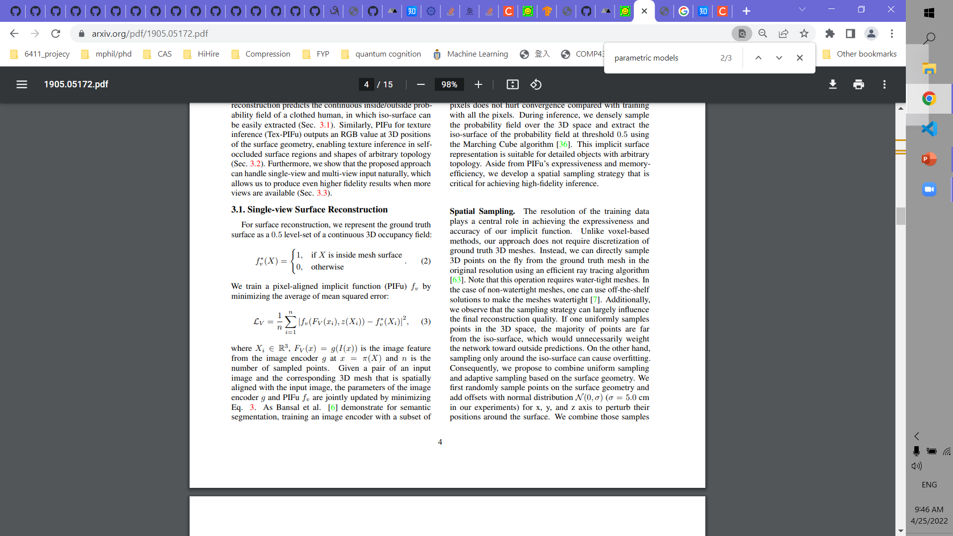

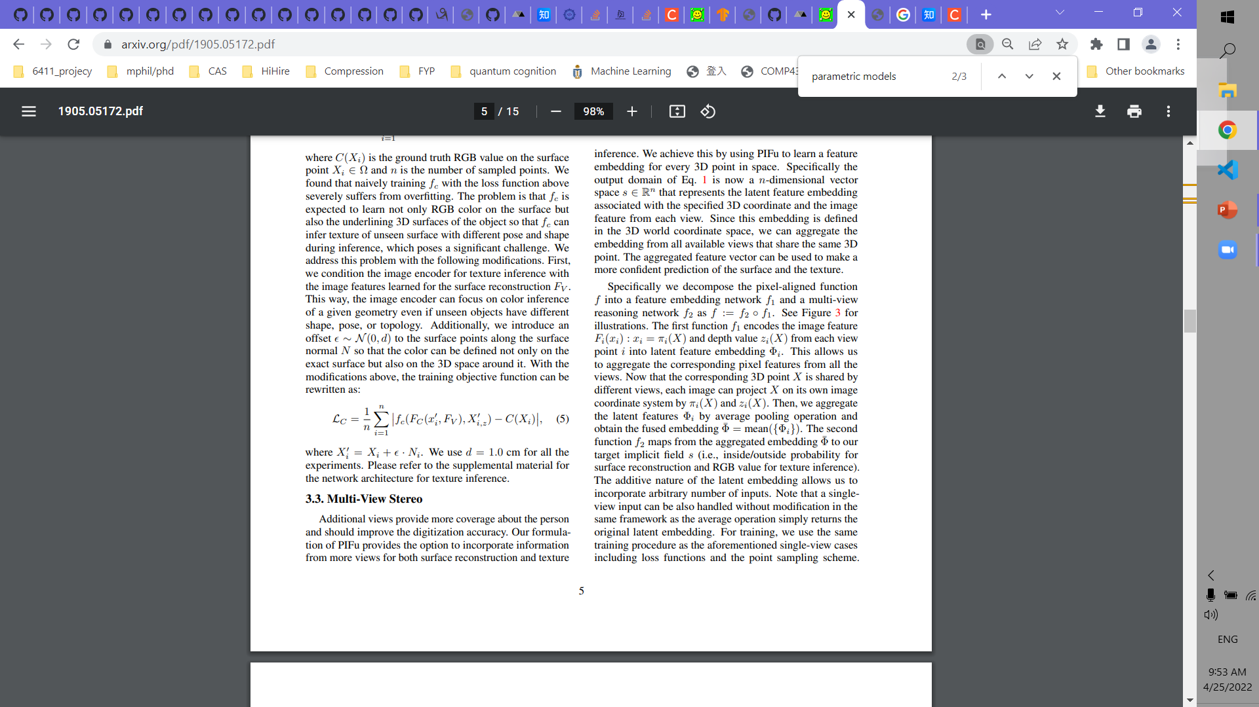
Proposed Method Formulation
Occupancy Function
Loss Function
Surface branch
where Xi ∈ R³ , Fi (x) = g(I(x)) is the image feature from the image encoder g at x = π(X) and n is #(sampled points)
Color branch
where X’_{i} = X_{i} + e· N_{i} , offset e ∼ N (0, d) , d=1.0cm in practice

Slide 34
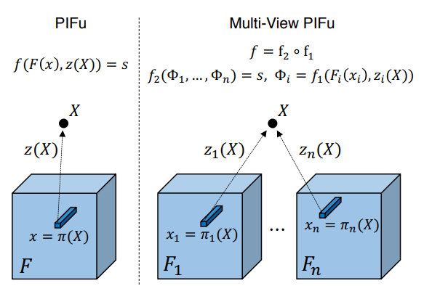
Proposed Method Formulation
Multi-View
Aggregate the latent features Φ_{i} by average pooling operation and obtain the fused embedding Φ = mean({Φ_{i}})

Slide 35
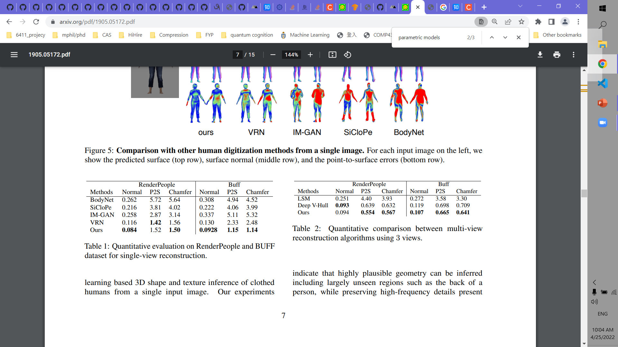
Experiments – Single-View and Multi-View Comparsion

Slide 36
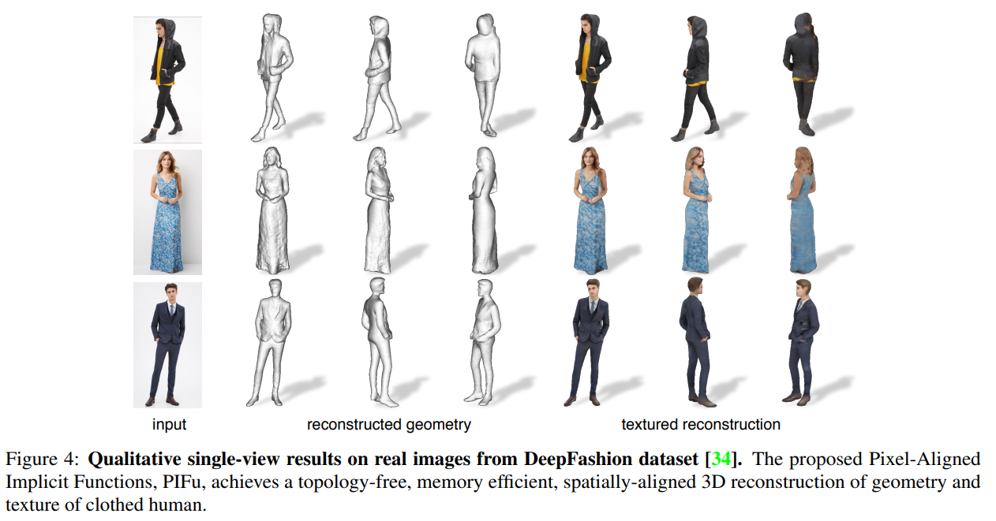
Experiments – Visualization

Slide 37
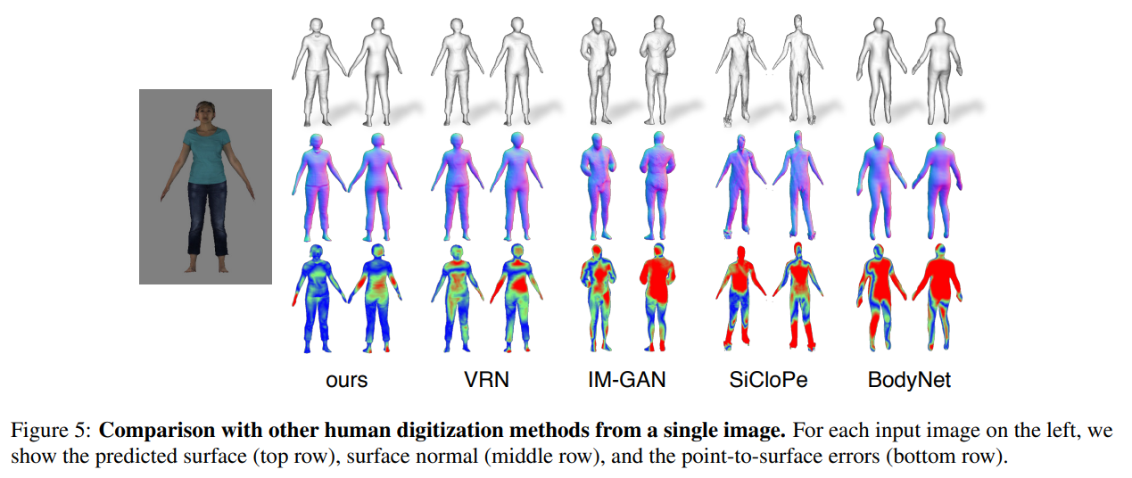
Experiments – Visualization

Slide 38
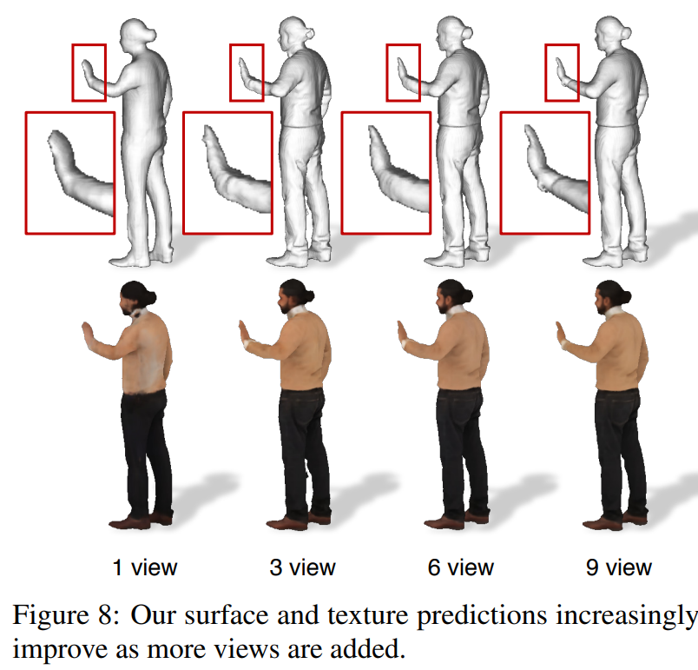
Experiments – Effectiveness of Multi-view

Slide 39
Thank you! Questions?

Slide 40
Non-Static NeRF
— Representing Dynamic Scenes
Presenter: Junming CHEN

Slide 41
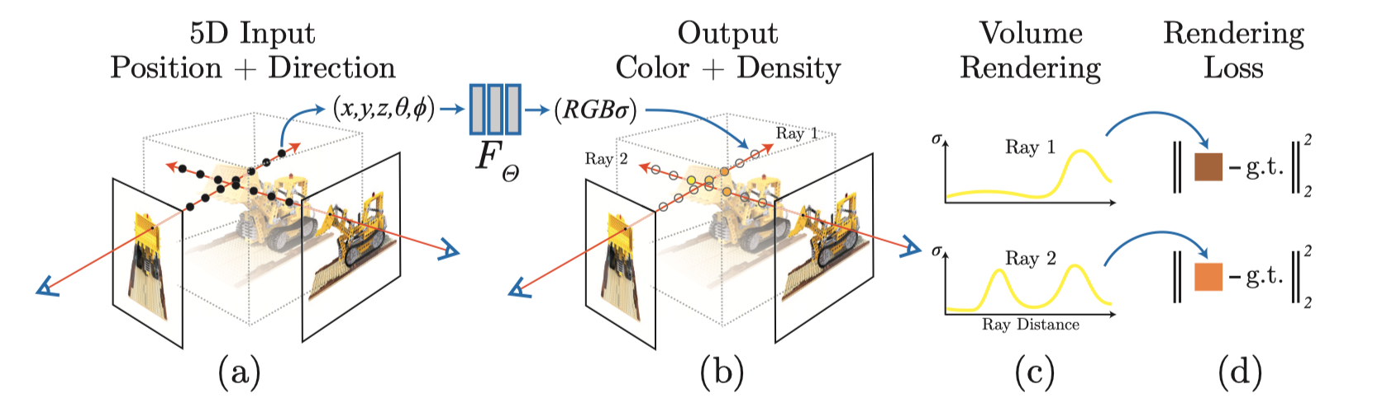
Recap NeRF
Static Scenes (Show Method pic and Results Gif)
However, NeRF assumes the scene to be Static

Slide 42
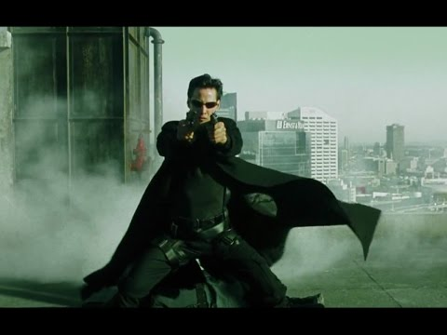
How About Dynamic Scenes?
Can have implicit representation for Dynamic Scenes?
Bullet-Time Effect (The Matrix)
Free-view rendering at any frame

Slide 43
Extending NeRF to Dynamic Scene
Static NeRF: F(x,y,z, θ,φ) = R,G,B, σ
→ Non-static NeRF: F(x,y,z, θ,φ, ?) = R,G,B, σ
Method 1: Space-time NeRF
Additionally conditioned on Time
Neural scene (radiance) flow: F1 → F2 → … → Fn
F(x,y,z, θ,φ, T) = R,G,B, σ
Method 2: Dynamic NeRF
Additionally conditioned on Deformation code
Canonical view + Deformation field → Observation view
F(x,y,z, θ,φ, D) = R,G,B, σ

Slide 44
Non-Static NeRF Papers
Space-time NeRF (Add time dimension to NeRF)
Space-time Neural Irradiance Fields for Free-Viewpoint Video, CVPR'21 [project]
Neural Scene Flow Fields for Space-Time View Synthesis of Dynamic Scenes, CVPR'21 [project]
Neural Radiance Flow for 4D View Synthesis and Video Processing, ICCV’21 [project]
Dynamic view synthesis from dynamic monocular video. ICCV'21 [project]
Dynamic NeRF (Canonical + Deformation)
D-nerf: Neural radiance fields for dynamic scenes. CVPR'21 [project]
Nerfies: Deformable neural radiance fields. ICCV'21 [project]
Non-Rigid Neural Radiance Fields: Reconstruction and Novel View Synthesis of a Dynamic Scene From Monocular Video. ICCV'21 [project]
HyperNeRF: A Higher-Dimensional Representation for Topologically Varying Neural Radiance Fields, SIGGRAPH Asia’21 [project]

Slide 45
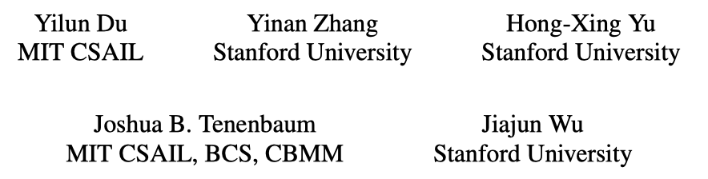
Neural Radiance Flow for 4D View Synthesis and Video Processing
ICCV 2021

Slide 46
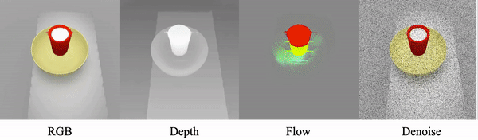
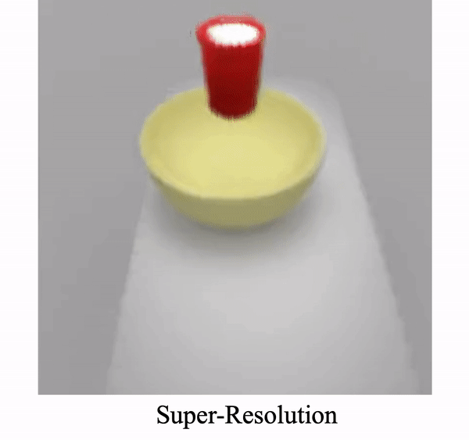
Highlights
NeRFlow: a spatial-temporal NeRF
Enables novel 4D view synthesis across both space and time
Effective with limited observations down to only one camera
By introducing a series of temporal consistency constraints
Can serve as an implicit scene prior
Outperforming classical and internal learning methods in super-resolution and image de-noising

Slide 47
Preliminary: NeRF
F_nerf(x,y,z, θ,φ) = R,G,B, σ

Slide 48
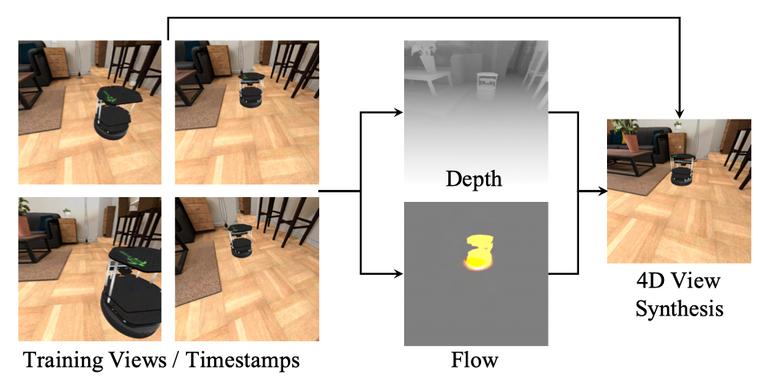
NeRFlow: Overview
Input: video(s) captured by (as few as one) cameras with known camera parameters.
Output: an implicit space-time neural radiance field.
F_nerflow(x,y,z, θ,φ, t) = R,G,B, σ

Slide 49
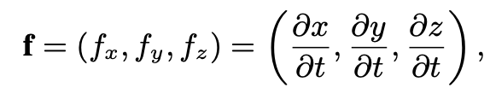
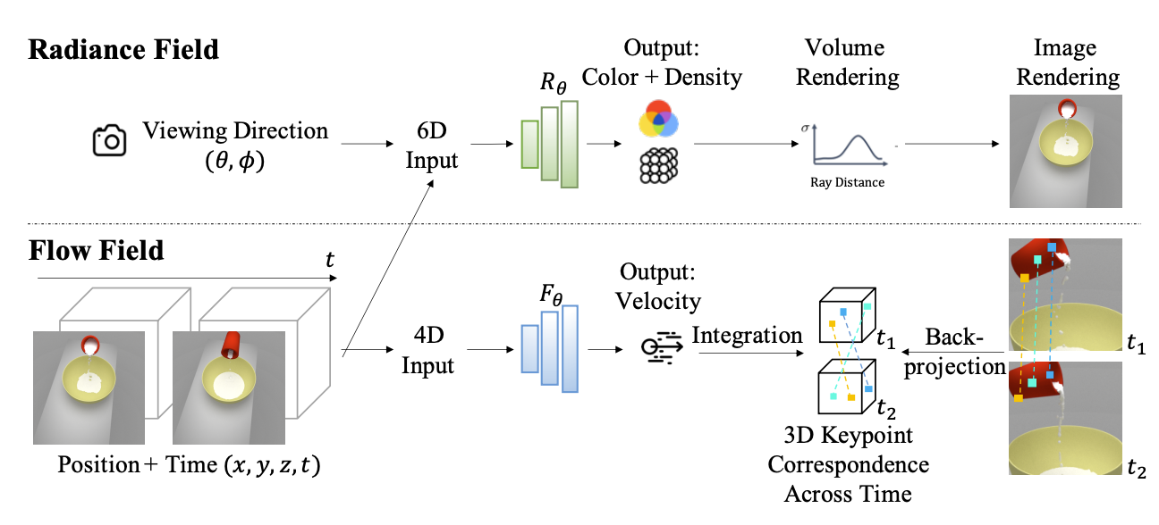
NeRFlow: Framework
Radiance Field: R(x,y,z, θ,φ, t) = R,G,B, σ
c=(R,G,B) is decomposed into
view-invariant diffuse part c_diffuse
view-dependent specular part c_specular
Flow Field: F(x,y,z, t) =
Notes:
Since specularity is typically sparsely observed, during training we add an L2 regularization loss to the magnitude of c_specular .

Slide 50
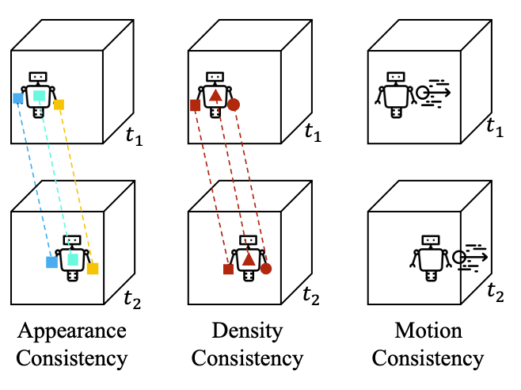
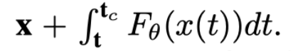
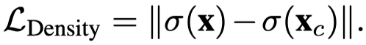
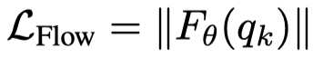
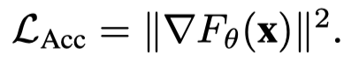
NeRFlow: Temporally Coherent Learning
3D Keypoint correspondences
Given randomly sampled 3D point x
Find corresponding point x_c at future timestamp t_c through flow function F:
x_c =
Consistencies
Appearance consistency.
The diffuse reflectance of an object remains constant while it is moving around.
Density consistency.
The solidity of an object naturally remains constant while it is moving.
Motion consistency.
Empty space looks static
Enforce that areas with low density must exhibit low flow.
Objects move smoothly in natural scenes
Encourage the flow function to be smooth across both space and time.
Notes:
Motion consistency:
To implement this, we cast N query points along a camera ray r, and select the first K query points q k such that transmittance of the remaining camera points is greater than 0.99. We then penalize the L 2 magnitude of each queried point via L Flow = ∥F θ (q k )∥.

Slide 51
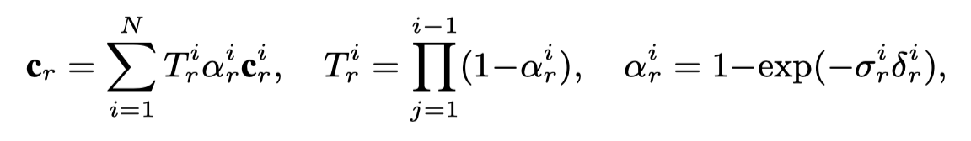

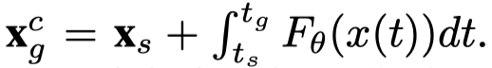
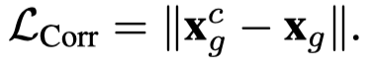
NeRF: Learning from Visual Observation
Volume rendering for image supervision.
Predict color through Volume rendering:
Loss:
Optical flow supervision.
One of the supervision for the prediction of the 3D scene flow field.
Serve as a “ground truth” for 3D point correspondence.
Optical flow (Farnback’s method) + depth map → back project to 3D scene space
Get “ground truth” corresponding points x_s at timestamp s and x_g at timestamp g
Our predicted candidate point:
Loss:

Slide 52
Experiments: Datasets
Pouring
Contains fluid dynamics
Gibson
A simulator for robotics motion
Real Images
Ice and Vase from [43]
Monocular real world videos from [38] and [80]

Slide 53
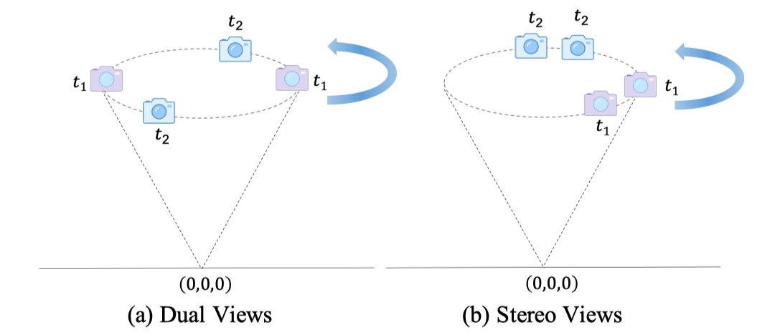

Experiments: 4D view synthesis

Slide 54


Experiments: 4D view synthesis

Slide 55

Experiments: 4D view synthesis

Slide 56


Experiments: Video Processing
Denoising
SR

Slide 57
Discussion
Does not explicitly address the ambiguities in both 3D geometry and dynamic regions.
Such ambiguity leads to difficulty in modeling complex real scenes and in preserving static backgrounds over time.

Slide 58

Non-Rigid Neural Radiance Fields: Reconstruction and Novel View Synthesis of a Dynamic Scene From Monocular Video
ICCV 2021

Slide 59

Demo

Slide 60

Method: NR-NeRF
Idea: Deformed Volume = Canonical Volume ⨁ Deformation
Deformation model: Ray Bending Network (an MLP): b(x, li)
li is the learnt latent code for each time step.
b(x, li) outputs the offset.
Assumption: Lambertian materials
Original NeRF: v(x, d) = (c, o)
NR-NeRF: v(x + b(x, li)) = (c, o)
Remove the view-dependent layers in original NeRF, i.e., c = c(x), instead of c(x,d).

Slide 61

Method: NR-NeRF
NR-NeRF: v(x + b(x, li)) = (c, o)
Canonical Volume: (c, o)
For each frame, deform into canonical view
Deformation Model: Ray Bending Network: b(x, li) = w(x)b′(x, li)
Rigidity Network: rigidity mask w(x) ∈ [0, 1]
For rigid objects, prevent deformations: w(x) → 0
For non-rigid objects, we want w(x) > 0.
Notes:
“Rigid” in this paper seems to refer “Static”

Slide 62

Method: NR-NeRF Losses
Reconstruction Loss:
Coarse and fine networks.
Regularization on Offsets:
Motivation: Let visually unoccupied and occluded space (i.e., air) to be compressible and not hinder the optimization
Weigh each point by transmittance and occupancy αj = V (j) · o( ̃r(j)).
2−w( ̃r(j))
For non-rigid objects (w → 1): → ℓ1 loss
Gradient is independent of the offset magnitude
For rigid objects (w → 0): → ℓ2 loss
Offset magnitude → 0 ⟹ Gradient → 0:
Preventing noisy gradients for the tiny offsets of rigid objects.
Notes:
Offsets Loss: we want visually unoccupied and occluded space (i.e., air) to be compressible and not hinder the optimization, we weigh the loss at each point by its opacity.

Slide 63


Method: NR-NeRF Losses (Cont’)
Divergence Loss:
Regularization of hidden areas
Preserve the local shape after deformation as much as possible
Regularize the absolute value of the divergence of the offsets field
Divergence:
Full Loss:
The weights ω_rigidity, ω_offsets, and ω_offsets are scene-specific.
Notes:
Offsets Loss: we want visually unoccupied and occluded space (i.e., air) to be compressible and not hinder the optimization, we weigh the loss at each point by its opacity.

Slide 64

Experiments: Reconstruction & Novel-view Rendering
Reconstruction
Novel view-point

Slide 65
Experiments: Reconstruction & Novel-view Rendering
Reconstruction
Novel view-point
Fixed
Moving

Slide 66
Experiments: Comparisons
Reconstruction
Neural volume: flickering
Others all good
Novel view synthesis
Other methods fails to generate clear and consistent frames

Slide 67
Experiments: Visualizations
Rigidity score
Bended rays

Slide 68

Experiments: Ablations
Regularization losses
Rigidity network
Notes:
Metric: background stability.
Figure 6. Ablation Study. We quantify the impact of our main design choices on background stability. To that end, we render the entire input sequence into a fixed novel view for all time steps and compute the standard deviation of each pixel’s color across time to measure color changes and hence background stability.
a) We show cumulative plots across all pixels, where our full method (left-most curve) has the most stable background.
b) We then show how those instabilities are distributed in the scene. The results of NR-NeRF show the least instability in the background.

Slide 69
Experiments: Editing
Magnitude of Motion
Foreground removal
Rigidity score
Forced background stabilization
Notes:
Metric: background stability.
Figure 6. Ablation Study. We quantify the impact of our main design choices on background stability. To that end, we render the entire input sequence into a fixed novel view for all time steps and compute the standard deviation of each pixel’s color across time to measure color changes and hence background stability.
a) We show cumulative plots across all pixels, where our full method (left-most curve) has the most stable background.
b) We then show how those instabilities are distributed in the scene. The results of NR-NeRF show the least instability in the background.

Slide 70
Conclusion
A free viewpoint rendering method, NR-NeRF.
The spatio-temporal camera trajectory for test-time novel view synthesis can differ significantly from the trajectory of the input video.
A rigidity network
Can segment the scene into nonrigid foreground and rigid background
Regularizers on the estimated deformations
Encouraging small amount of points preserving deformations
Simple scene editing
Foreground removal
Forced background stabilization

